Slide 1
Econ 490 Game Theory
Class 4 Simultaneous Move Games in Continuous Strategies and the Concept of Rationalizability

Slide 2
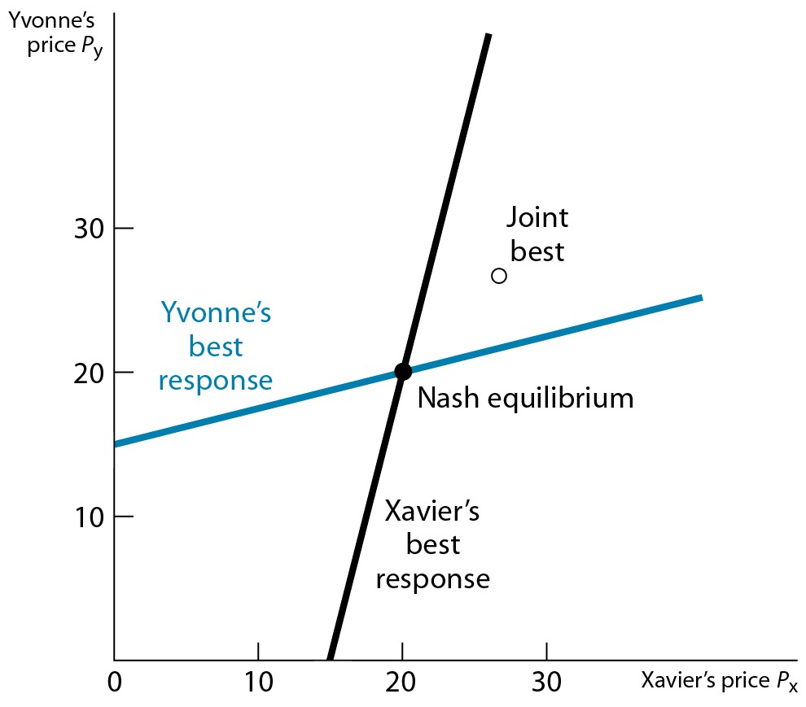
Price Competition Among Two Firms
See Ch5 Appendix if you’re unfamiliar with Function Maximization
Notes:
5.1.A

Slide 3
Price Competition Among Two Firms
Suppose there are only 2 movie theaters in Champaign: Carmike 13 (C), which shows first-run movies and Virginia Theater (V), which shows movies that have been out for a while. The demand for movies at Carmike is given by Q_{C}=14-P_{C}+P_{V}, while the demand for movies at Virginia is Q_{V}=8-2P_{V}+P_{C}, where prices are in dollars and quantities are measured in hundreds of moviegoers. Carmike 13 has a per-customer cost of $4, while Virginia has a per-customer cost of $2.
Notes:
Ch5 U2

Slide 4
Price Competition Among Two Firms
From the demand equations alone, what indicates whether Carmike 13 and the Virginia Theater offers services that are substitutes of complements?
Write the profit function for each theater in terms of P_{C} and P_{V}. Find their best response rules.
Find the Nash Equilibrium price, quantity, and profit for each theater.
What would each theater’s price, quantity, and profit be if the two decided to maximize joint profits in this market? Is this outcome a Nash Equilibrium?

Slide 5
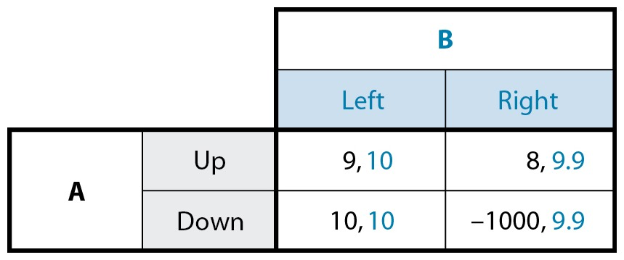
Incorporating Risk in NE
What would you choose if you were A?

Slide 6
Incorporating Risk in NE
Suppose A thinks there is a probability p that B’s payoffs from Left and Right are the reverse of what we seen just now.
Expected payoff from playing Up: 9(1-p)+8p
Expected payoff from playing Down: 10(1-p)-1000p
Hence, A should choose Up as long as p>1/1009
Results show that risk is a factor that can usually be incorporated into our analysis.

Slide 7
Discussions on Nash Equilibrium
When is NE a good prediction of real world games?
Games that have a unique equilibrium
Players have experience playing these or similar games with similarly experienced others.

Slide 8
Discussions on Nash Equilibrium
When does NE tend to fail as a reliable prediction?
The players’ objectives or payoff functions are different from what the game theorist assumed when analyzing the game.
The calculations involved in solving for the Nash equilibrium were too complex or unfamiliar.
There were multiple Nash equilibria and no adequate device available for selecting one of them.

Slide 9
Rationalizability
A player is said to be rational if he plays a best response to a belief about the other players’ strategies.
The set of strategies that survive elimination of strategies that are never a best response are called rationalizable, and the concept itself is called rationalizability.

Slide 10
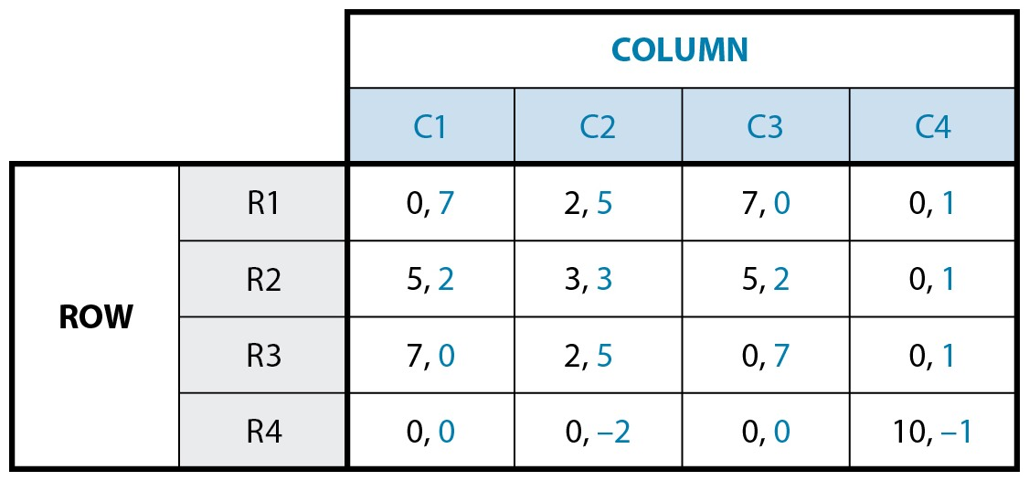
Rationalizability

Slide 11
Rationalizability
C4 is not dominated by C1, C2, C3, but also never a best response to any of Row’s strategies.
When mixed strategies dominance is excluded, “never a best response” is more general than “dominated”.
Hence, eliminating strategies that are never a best response can narrow down the set of possible outcomes more than elimination of dominated strategies. For example, we’ve can reduce the above game to R1-R3 and C1-C3 with rationalizability while no reduction is available with dominance.

Slide 12
How far can we go with Rationalizability?
If a Nash equilibrium exists, it is always rationalizable.
But even if there’s no NE, there still might be rationalizable outcomes.
But sometimes, if we’re lucky, rationalizability can take us all the way to NE.

Slide 13
How far can we go with Rationalizability?
1\2 | L | R
U | 2,0 | -1,1
M | 0,10 | 0,0
D | -1,-6 | 2,0
Is there a dominated strategy here?
If player 1 is rational, what would he play?
If player 2 is rational, what would she play?
If player 2 is rational and she knows that player 1 is rational, what would she play?
If player 1 is rational and he knows that player 2 is rational and he knows that player 2 knows player 1 is rational, what would he play?

Slide 14
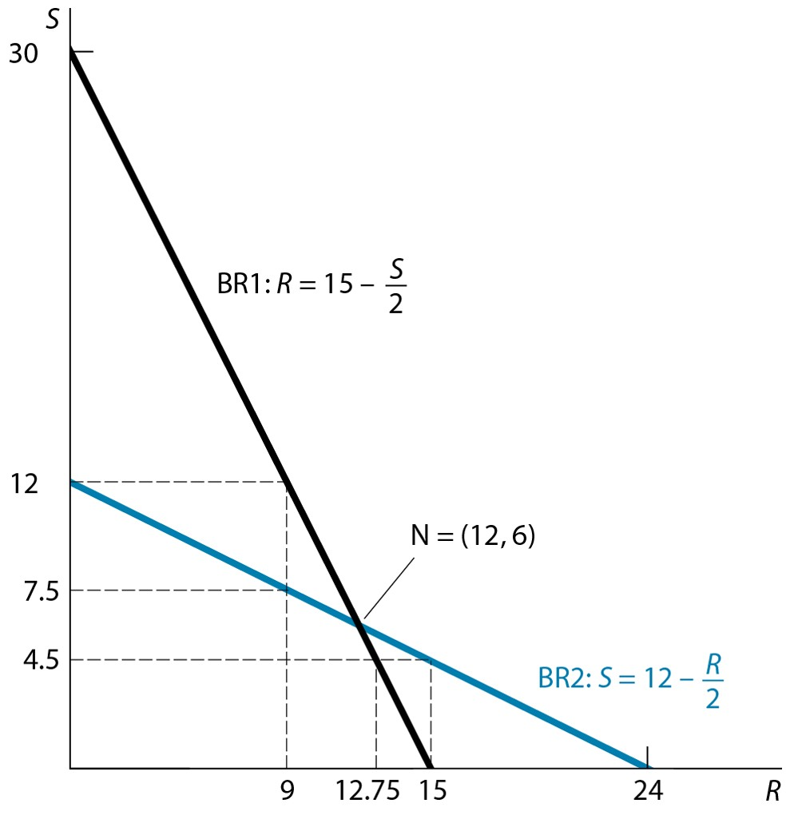
Pushing Rationalizability to NE

